Slide 3
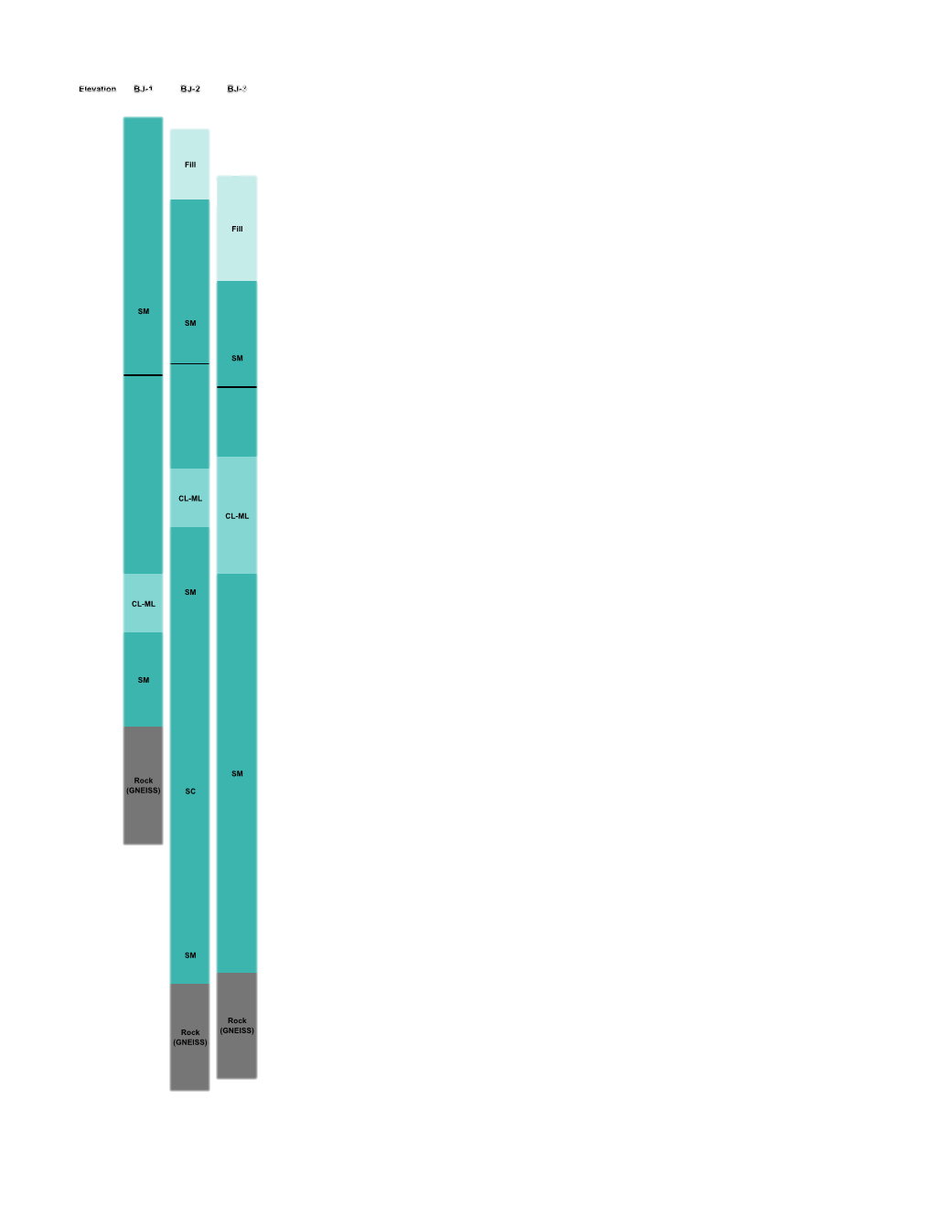
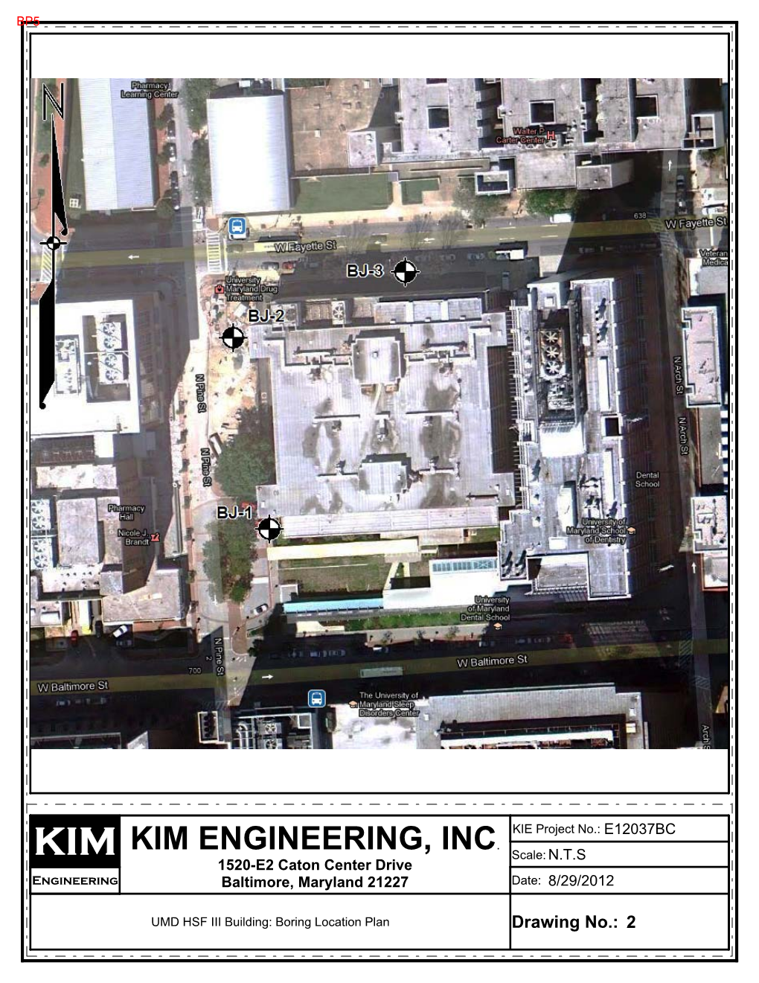
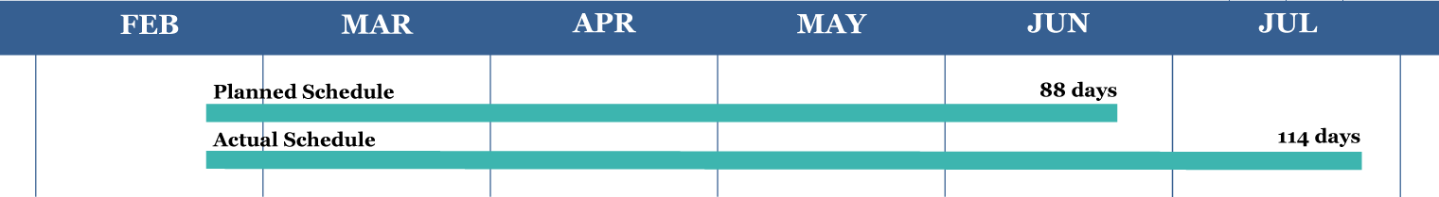
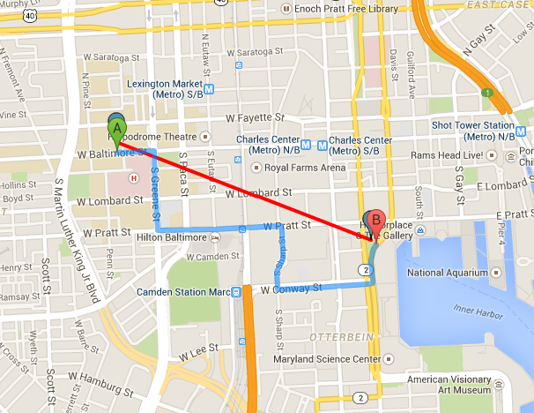
Current System | Pile and Lagging
Shoring | $1,480,000
Dewatering Issues | $650,000
New Total | $2,130,000
.712 miles

Slide 4
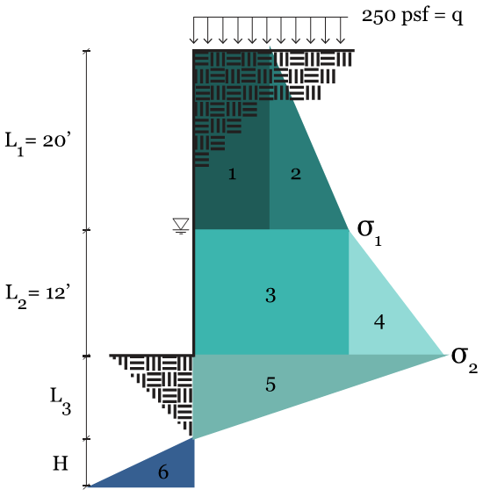
Soil Property | Amount | Unit
Water Table | 20 | ft
Angle of Friction, φ | 35 | Degrees (°)
Moist Unit Weight, γ | 125 | pcf
Saturated Unit Weight, γ_{SAT} | 145 | pcf
Construction surcharge, q | 250 | psf
Allowable bearing, q_{a} | 5000 | psi
Soil Type | SM | --

Slide 7
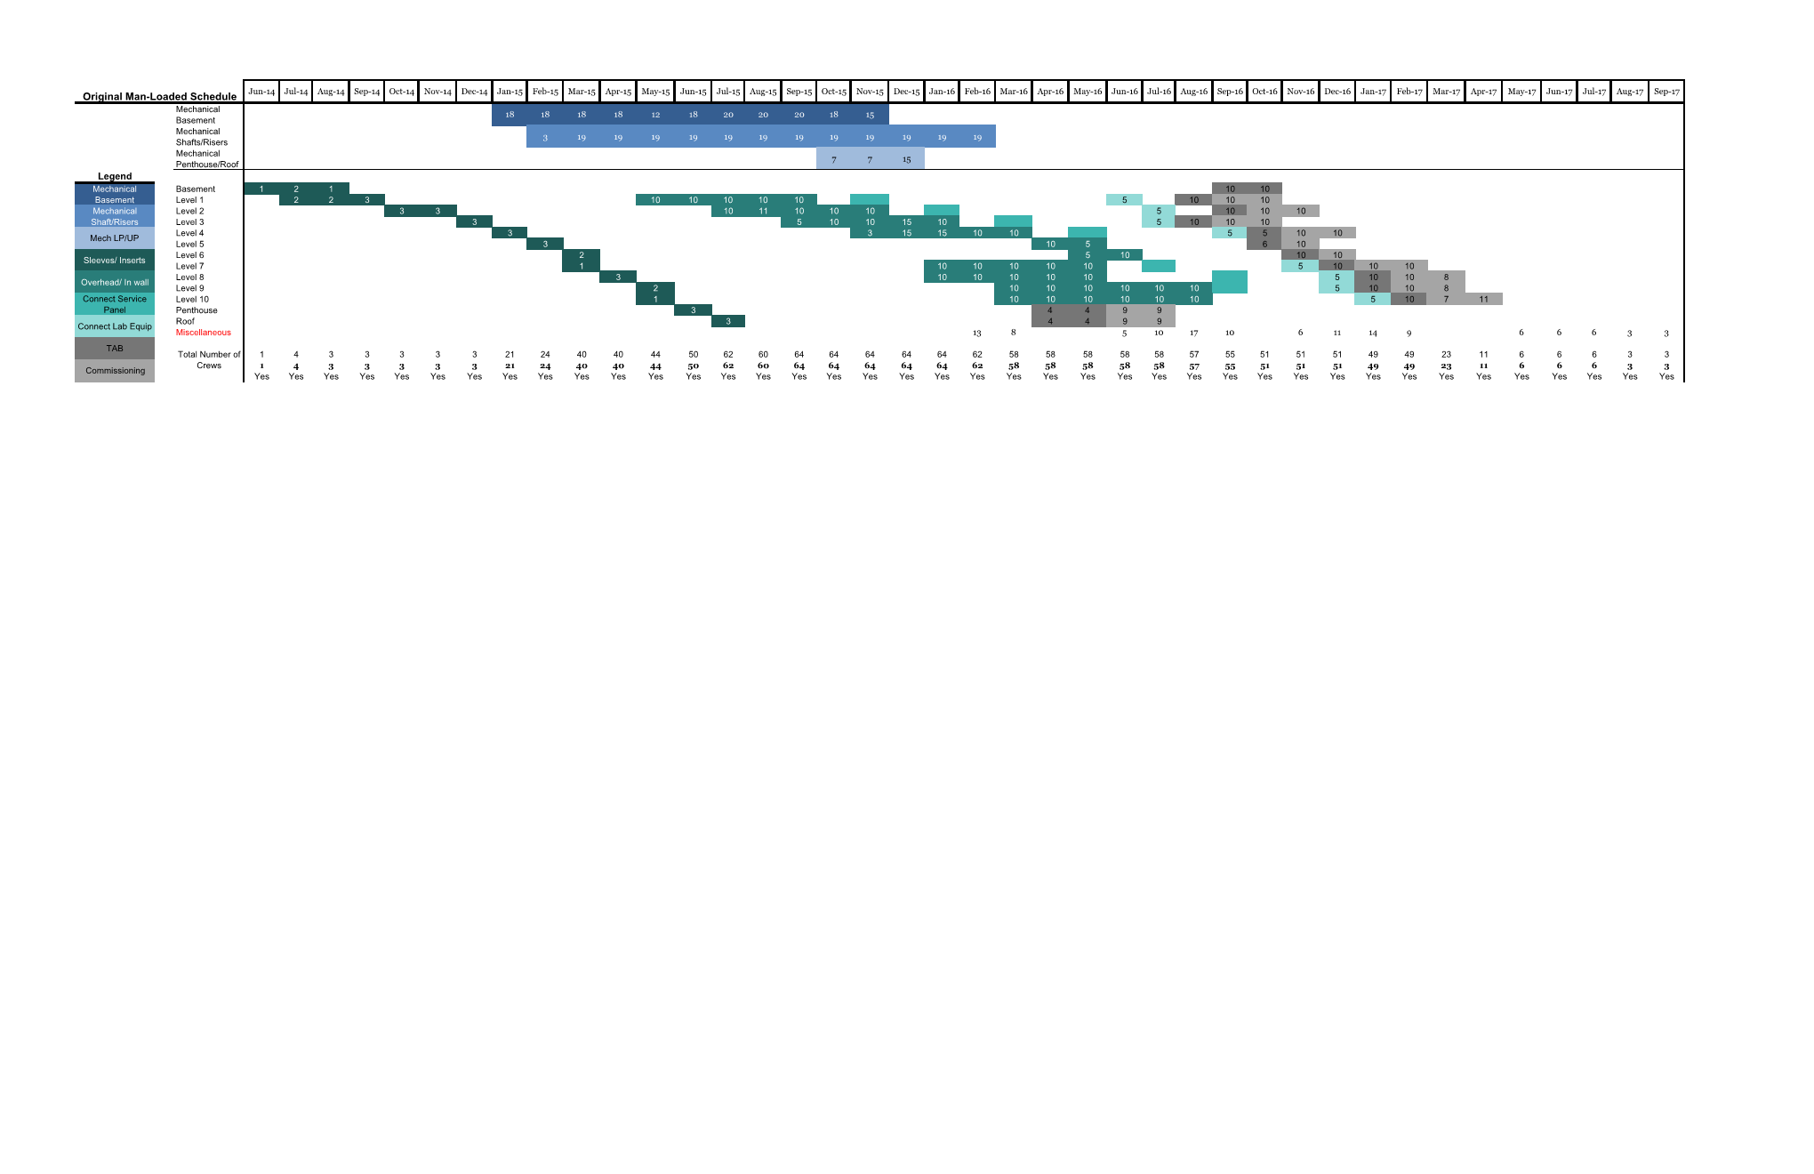
Original Man-loaded Schedule

